Slide 1
CG1112
Week 5 – Studio 1
Timer (tick tock tick tock)

Slide 2
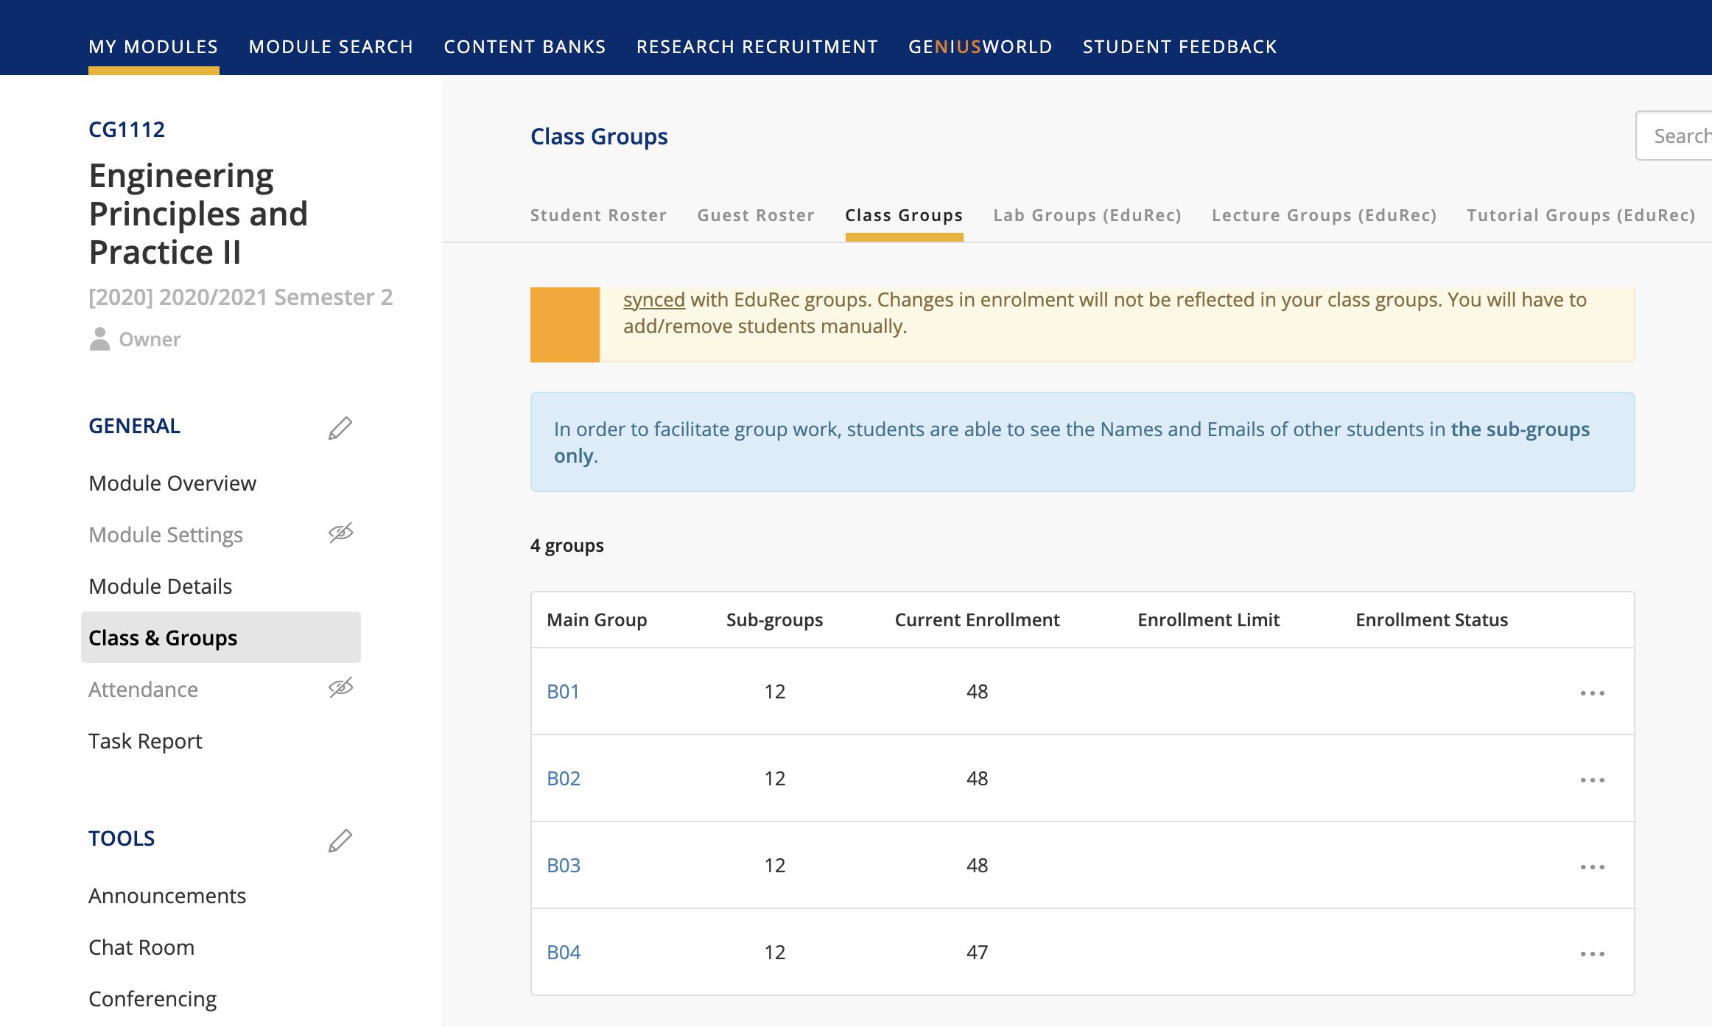
Please take 5 minutes to register for your project group
Go to LumiNUS.
Click “Class and Groups” on the left bar, then “Class Groups” on the top bar. Click “B01” or “B02” etc.

Slide 3
Please take 5 minutes to register for your project group
Choose your respective project group according to the map on the next page and sign up.
If you are in Section 1 on the A side, your group is 1 B0x-1A (where x is your studio number. E.g. B03-1A)
You may swap sides within a section. E.g. 1A->1B or 1B->1A
Maximum of 5 persons in a group. Do not sign up for the wrong group.
You are not allowed to join a group in a different section. E.g. if you are in Section 2, you cannot join group 3A.

Slide 4
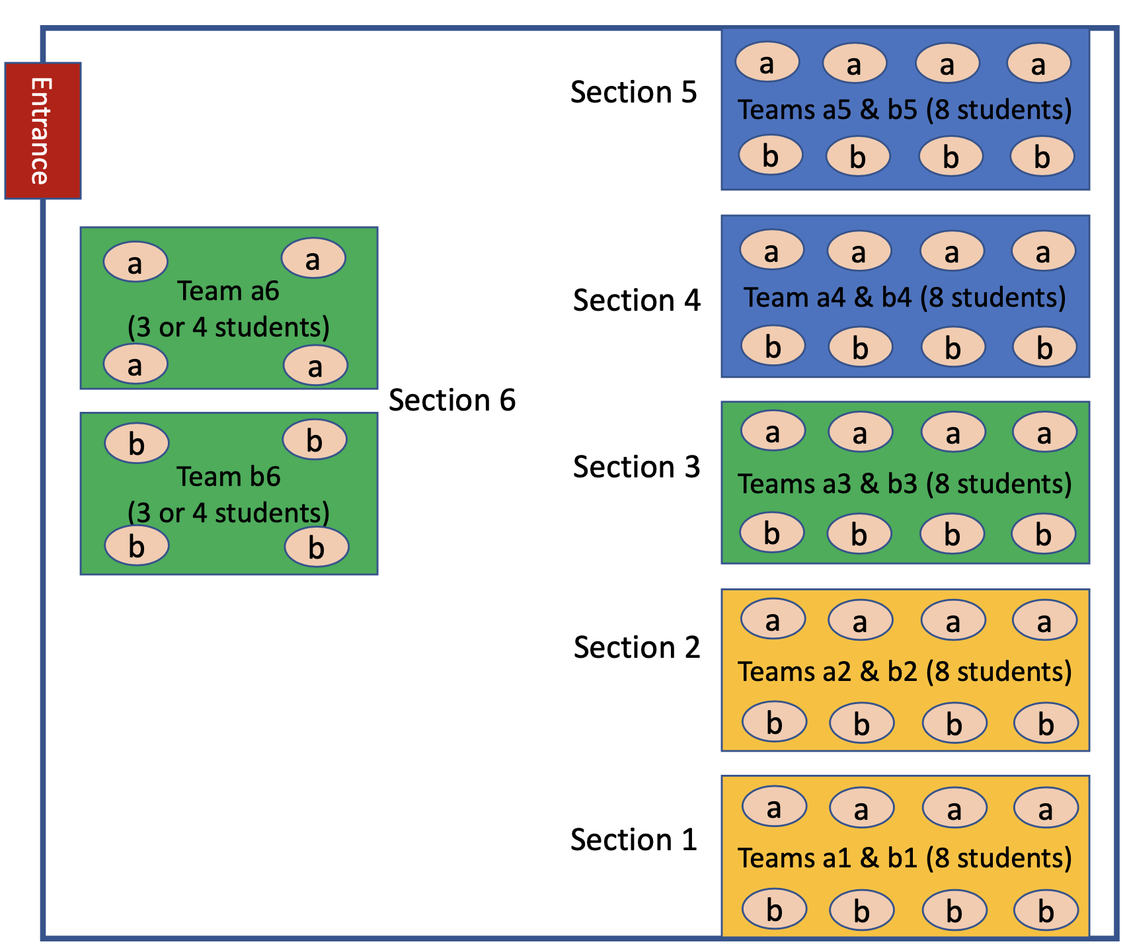

Slide 5
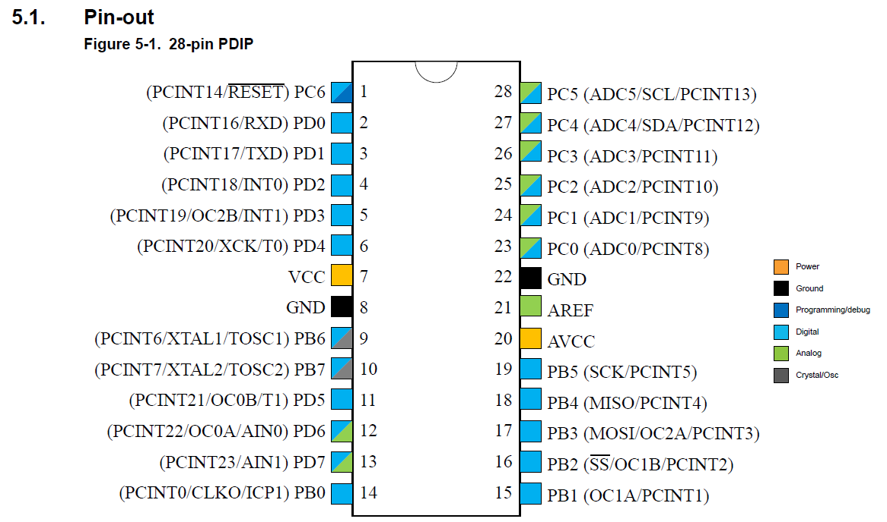
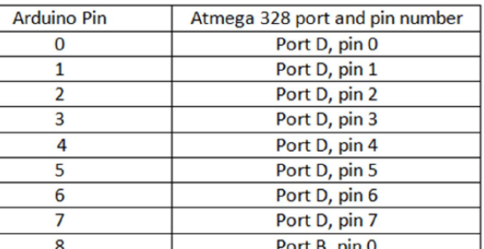
Oh, OC0A is PD6, which is Pin 6??

Slide 6
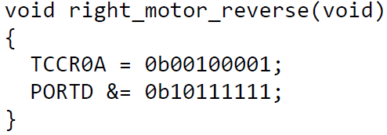
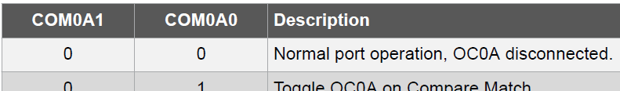
OC0A interaction with PD6
 | 7 | 6 | 5 | 4 | 3 | 2 | 1 | 0
PORTD

Slide 7

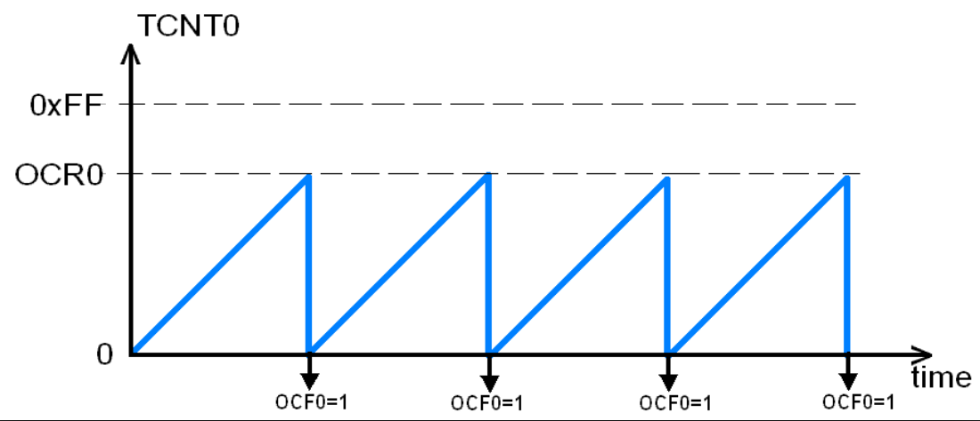
Clear Timer on Compare (CTC)
Frequency 🡺 Duration
Prescaler

Slide 8
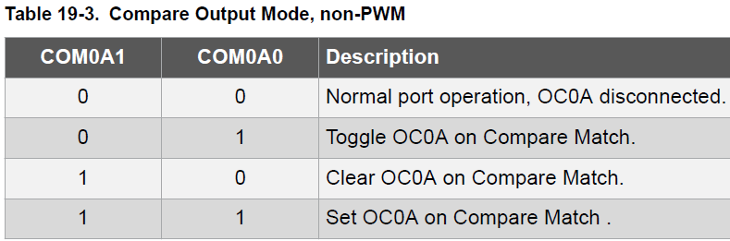

CSn2 | CSn1 | CSn0 | Description
0 | 0 | 0 | Stop
0 | 0 | 1 | clk_{IO} / 1
0 | 1 | 0 | clk_{IO} / 8
0 | 1 | 1 | clk_{IO} / 64
1 | 0 | 0 | clk_{IO} / 256
1 | 0 | 1 | clk_{IO} / 1024
TC0 and TC2
TCCRnA | CmA1 | CmA0 | CmB1 | CmB0 | 3 | 2 | WGM1 | WGM0
OCRnx (8 bit)
TCCRnB | 7 | 6 | 5 | 4 | WGM2 | CSn2 | CSn1 | CSn0
TCNTn (8 bit)
TIMSKn | 7 | 6 | 5 | 4 | 3 | 2:OCIEB | 1:OCIEA | 0
cli() sei()
TC1 only
TCCR1A | CmA1 | CmA0 | CmB1 | CmB0 | 3 | 2 | WGM11 | WGM10
OCR1A (16 bit)
TCCR1B | 7 | 6 | 5 | WGM13 | WGM12 | CS12 | CS11 | CS10
TCNT1 (16 bit)
WGM13 | WGM12 | WGM11 | WGM10 | Mode | TOP
0 | 1 | 0 | 0 | CTC | OCR1A

Slide 9
Recommended Steps for SetupTimer()
cli(); //Disable all interrupt
TCCRnA = ......;
TCCRnB = 0; //Clear CS bits initialized by Arduino
TIMSKn = ......; //If Timer Interrupt is used
TCNTn = 0;
OCRnA = ......;
sei(); //Enable all interrupt

Slide 10
ERRATA
Page 4 Question 5 Step 3:
“Locate the following segment of code in the w6s2p1 w5s1p1 sketch”
Page 5 Activity 2:
“Create a new Load the Arduino sketch called w5s1p2”

